Slide 1
Linux System Maintenance
Prepared by: Ms. Parveen Mor Dahiya

Slide 2
Upgrading & Customizing the kernel
Upgrading the kernel and customizing the kernel refer to two different procedures, although both require recompiling and installing the kernel. Customizing the kernel refers to reconfiguring an existing kernel source code tree, recompiling it, installing the new kernel, and booting it.
Upgrading the kernel means obtaining an updated version of the kernel source code, recompiling, installing, and booting the new kernel. To put it another way, upgrading the kernel means obtaining new source code and customizing it.

Slide 3
You can recompile the kernel to support your specific CPU, especially features that improve performance. The default Red Hat Linux installation installs a kernel configured to run on the widest possible variety of Intel CPUs. As a result, it does not take advantage of all the features and improvements available in the newest CPUs.
Similarly, the default kernel often includes system features that you do not need or does not include features that you do need or want. Customizing and recompiling the kernel enables you to remove unnecessary or unwanted features and to add needful and desired features.

Slide 4
The default kernel supports an enormous variety of the most common hardware, but no single system needs all of that support. You might want to create a new kernel that includes support for only the hardware actually installed on your system.
If you have a system with hardware not supported when you installed Red Hat Linux or for which only experimental support was available, you can rebuild the kernel to include that support once it becomes available or to improve existing support.

Slide 5
Checking Kernel Version
To find out which kernel is currently running on your system, open a shell and type
uname –a
which should output something such as:
Linux eeepc 2.6.26.5-eeepc #13 PREEMPT Thu Oct 9 04:04:42 CEST 2008 i686 GNU/Linux
Another command
cat /proc/version
provides additional information on the compiler used to build the kernel.

Slide 6
The -v option consists of a sequence number followed by a date and time stamp, useful information if you build several kernels in a single day:
$ uname -v
#1 Tue Jul 24 14:54:56 EDT 2001
Another way to check which version of the kernel you are running is to query the RPM database. You can use either of the following commands. The first command shows only the version of the kernel binary that is installed.
$ rpm -q kernel
kernel-2.4.6-3.1
The next command shows all the kernel related RPMs installed.
$ rpm -qa | egrep kernel
kernel-headers-2.4.6-3.1 kernel-doc-2.4.6-3.1 kernel-source-2.4.6-3.1 kernel-2.4.6-3.1

Slide 7
The second command queries the entire RPM database and uses the egrep command to show only the output lines that contain the word “kernel.” If you are considering rebuilding your kernel, the second command is probably more useful to you because it lets you know which kernel related packages you have installed. The following list briefly describes each package.
kernel-headers: Contains the C header files for the Linux kernel. The header files define structures and constants that are needed for building most standard programs, and are also needed for rebuilding the kernel.
kernel-doc: Contains documentation files from the kernel source. Various portions of the Linux kernel and the device drivers shipped with it are documented in these files. Install this package if you need a reference to the options that can be passed to Linux kernel modules at load time.
kernel-source: Contains the source code files for the Linux kernel.
kernel: Contains the Linux kernel, the core of the Red Hat Linux operating system.

Slide 8
Customizing the kernel
When con- figuring the kernel, you have two options for the device drivers needed to support various hardware devices in Linux:
Build device support directly into the kernel. You can build the drivers for all hardware on your system into the kernel. As you can imagine, the size of the kernel grows as device driver code is incorporated into the kernel. A kernel that includes all necessary device driver support is called a monolithic kernel.
Use modules to provide device support. You can create the necessary device drivers in the form of modules. A module is a block of code that the kernel loads and unloads on an as-needed basis while it is running. Modules enable you to add support for a device without having to rebuild the kernel for each new device you add to your system. Modules do not have to be device drivers; you can use them to add any sort of new functionality to the kernel. A kernel that uses modules is called a modular kernel.

Slide 9
Update & install
Compile and install the kernel and modules:
make deb-pkg.
The make deb-pkg command will create five deb packages in /usr/src/ that you will need to install:
dpkg -i linux-*.deb.
Edit /etc/default/grub and add or change the variables to match. ...
Update the bootloader:
update-grub.

Slide 10
NETWORK CONFIGURATION USING THE COMMAND-LINE INTERFACE (CLI)
The commands for the ip utility, sometimes referred to as iproute2 after the upstream package name.
The package name in Red Hat Enterprise Linux 7 is iproute. If necessary, you can check that the ip utility is installed by checking its version number as follows:
~]$ ip –V
ip utility, iproute2-ss130716
The ip commands can be used to add and remove addresses and routes to interfaces in parallel with NetworkManager,.
To bring an interface up:
ip link set ifname up
To bring an interface down:
ip link set ifname down

Slide 11
uname COMMAND LINE OPTIONS
Option Description
-a Displays all information
-m Displays the hardware (CPU) type
-n Displays the system’s host name
-s Displays the operating system name (equivalent to uname)
-p Displays the system’s processor type
-v Prints the Linux version, that is, when it was compiled

Slide 12
Managing Users and Groups
One of the key administrative tasks with Linux is managing users and groups.
The primary reason for user accounts is to verify the identity of each individual using a computer system.
A secondary reason for user accounts is to permit the per-individual tailoring of resources and access privileges.
Resources can include files, directories, and devices. Controlling access to these resources is a primary task of an administrator

Slide 13
Groups tie together users that have a common purpose.
An organization may have persons responsible for accounts payable and others responsible for payroll.
By placing the user accounts in an accounts payable group then common permissions can be given to all the members of that group.
Members of the accounts payable group would not have access to the information and resources of the payroll group. Users within the same group have the same read, write. or execute privileges of group resources.

Slide 14
etc
Several files are used when creating users in Linux. The following are a few most commonly used.
/etc/passwd
/etc/shadow
/etc/group

Slide 15
/etc/passwd
The /etc/passwd file contains the user ID, and default home directory. Because this file is used by many tools it needs to be readable by any user.
To view the /etc/passwd file use the less command.
less /etc/passwd
The /etc/passwd file is a group of fields separated with a colon (:). They are username, password (shown as an x), numeric user ID, numeric group ID, full name, user’s home directory, and user’s shell account.

Slide 16
/etc/shadow
The /etc/shadow file contains the encrypted passwords and other password information.
This file is viewable by the root user only.
To view the /etc/shadow file use the following commands:
su – root
tail /etc/shadow
The /etc/shadow file is a group of fields separated with a colon (:). They are:
Username
password (13 characters encrypted)
the number of days since the password was last changed
the number of days before the password may be changed
the number of days to warn a user of an expiring password
the number of days after a password expires that account is disabled
the number of days since an account has bee disabled
a reserved field for possible future use.

Slide 17
Adding a User 1
Use the useradd command to add a user. The syntax of the command is displayed by typing the command alone.
useradd
The most basic command to add a user named John Smith with and user ID of jsmith is the following:
useradd jsmith
If you view /etc/passwd after the add you will see that jsmith has been added.
jsmith:x:501:501::/home/jsmith:/bin/bash
id:password(shadowed):Full Name:homeDir:shell
The full name can be added with the –c option. useradd –c “John Smith” jsmith

Slide 18
Adding a User 2
When a user is added the home directory is not created automatically. It is assigned but not created until the user logs in the first time. To force the home directory to be created use the –m option. The following command will create the jsmith user and create the associated home directory:
useradd –c “John Smith” –m jsmith
View the jsmith user home directory with the command:
ls /home/directory
Any files and directories that are in the /etc/skel directory are automatically copied into the newly created home directory. If /etc/skel has no files or directories (the default) then nothing is created.
The /etc/skel directory on this Linux system has a Documents directory and a Welcome file.

Slide 19
Adding a User 3
A look at the /etc/shadow file shows that jsmith was added but a password has not been assigned. The command to add a password is passwd. As root you can change the password for jsmith with the following command:
passwd jsmith
You will be asked to type the password and then repeat it to ensure it was typed correctly. The root user can change any user password. A user can change their own password by typing passwd without a user ID.
passwd has options to configure the minimum password lifetime, maximum password lifetime, and other options.

Slide 20
Deleting a User
Deleting a user is done as the root user with the userdel command. To delete the user jsmith use the command:
userdel jsmith
Userdel has one option, -r, which removes the user’s home directory as well as the account. To remove jsmith and the associated home directory, /home/jsmith, use the following command:
userdel –r jsmith
Once a user’s home directory is removed it would have to be restored from backup to recover it.
There may be orphaned files – files that are not associated by a valid user – when you delete a user
Example: jsmith was storing some files in /tmp. Those files are not deleted when the user jsmith is removed. Those files in /tmp are now orphaned.

Slide 21
Adding a Group
The mail file for groups is the /etc/group file. The file is a group of fileds that describe the group and who is a member of it. The fields in order are the group name, password (not used), numeric ID, and then a list of members separated by a comma.
A group is used to assign rights and permissions to users. For example, if you have several files that should be made available to users in the Accounts Payable department you could create an Accounts Payable group then add users to the group. Once the group is populated then the permissions of the file or directory can be changed to allow access by the group.
To add a group use the groupadd command.
groupadd AccountsPayable

Slide 22
Assigning Users to a Group
The usermod command is used to add users to a group.
It also has options to change the home directory, change the shell, and other values.
To use usermod to add users jsmith and jdoe to the AccountsPayable group type the following:
usermod –G AccountsPayable jsmith
usermod –G AccountsPayable jdoe

Slide 23
Changing Group Permissions
Groups can be used to assign privileges to resources, such as a directory.
to change the group to AccountsPayable. This is accomplished with the following command:
chgrp –R AccountsPayable AP
Where –R causes it to recursively affect files and directories within the AP directory, AccountsPayable is the new group, and AP is the name of the directory.
Permissions for group are then changed to give full read/write/execute access with the chmod command.
chmod 775 AP

Slide 24
Configuring Disk Quotas
Linux System Administration
A disk quota is a limit set by a system administrator that restricts certain aspects of file system usage on modern operating systems. The function of setting quotas to disks is to allocate limited disk-space in a reasonable way.
To implement disk quotas, use the following steps:
Enable quotas per file system by modifying /etc/fstab
Remount the file system(s)
Create the quota files and generate the disk usage table
Assign quotas

Slide 25
Configuring Disk Quotas
Linux System Administration
Enabling Quotas: Edit fstab to enable usrquota
LABEL=/1 / ext3 defaults 1 1
LABEL=/boot /boot ext3 defaults 1 2
LABEL=/users /users ext3 exec,dev,suid,rw,usrquota 1 2
LABEL=/var /var ext3 defaults 1 2
LABEL=SWAP-sda5 swap swap defaults 0 0

Slide 26
Configuring Disk Quotas
Linux System Administration
Remounting the File Systems: Issue the umount command followed by the mount command to remount the file system in which quota has been implemented (umount /users;mount /users)
Creating the Quota Database Files: Use quotacheck command to create quota.user file
quotacheck -cu /users
Assigning Quotas per User: assigning the disk quotas with the edquota command (edquota <username>)
Disk quotas for user web_cc (uid 524):
Filesystem blocks soft hard inodes soft hard
/dev/sdb1 988612 1024000 1075200 7862 0 0

Slide 27
Understanding Backup Strategies
A backup is a copy of data on a computer system
A backup plan is a written document that outlines when, how, and why various files will be backed up, stored, and restored
Backup media is the item that holds backed-up data
To restore data is to copy it from backup media back to the file system where that data is normally used, and from which it was lost

Slide 28
What files should be backed up?
Who will back up files?
Where are files located?
How should backups be performed?
Must you be able to restore data within a specific period of time?

Slide 29
Determining the Value of Data
A backup strategy should be based on the value of the data you are backing up
The dollar value and time sensitivity of the data stored on your Linux systems determines how much expense you can justify in creating a backup plan
The value of data includes several factors beyond the money paid to an employee to create the data

Slide 30
Determining When to Back up Data
You can select a strategy based on how often data on your system changes and how valuable or critical each incremental piece of data is
User data, log files, and e-mail archives change daily and are normally the focus of frequent backups

Slide 31
A Linux Backup Strategy
A Linux backup strategy is based on the standard three-level backup method
A multilevel backup system provides a reasonable trade-off between convenience and low cost on one side, and protecting data on the other

Slide 32
Using Backup Levels
A backup level defines how much data is to be backed up in comparison with another backup level
Level 0 is a full backup
A level 1 backup might be done once per week
A level 2 backup could then be done each day
Storing only files that have changed since a full backup is called an incremental backup

Slide 33
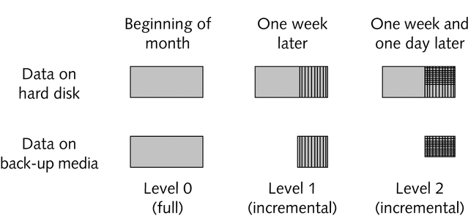
Backup Levels

Slide 34
Restoring a File from a Three-Level Backup
To locate a file you should follow the steps:
Check the most recent level 2 backup
Check the most recent level 1 backup
Check the most recent level 0 backup

Slide 35
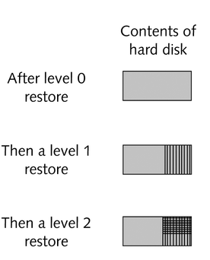
Restoring Data from a Three-Level Set of Backup Media

Slide 36
Managing and Storing Backup Media
You must determine how many backup media you will need (disks, tapes, cartridges) for each level
The strategy for off-site storage depends on how critical data

Slide 37
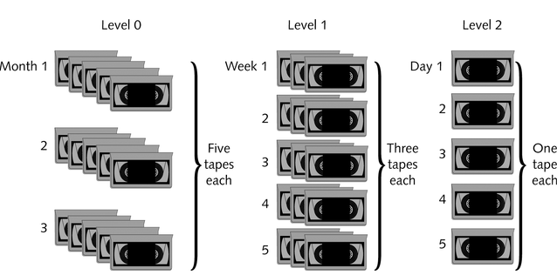
Multiple Tapes Used for a Three-Level Backup Plan

Slide 38
Backing Up the Root File System
Back up the root file system
Prepare to restore critical applications
Back up files:
The kernel modules
Configuration files
File indexes

Slide 39
Hardware and Software Issues
Linux includes all the necessary software utilities for many backup tasks
Many different hardware devices are available for backing up data

Slide 40
Choosing Backup Media
Storage space is measured according to its cost per megabyte or per gigabyte
You normally have multiple copies of the data on your system, backed up at different times

Slide 41
Magnetic Media
There are several types of magnetic media for backing up data:
RAID hard disks
Floppy disks
Removable magnetic media
Removable hard disks

Slide 42
Optical Media
Optical media include:
CDs
DVD-RAM disks
Standard CDs are a valuable method of exchanging data with suppliers and also of easily creating data archives

Slide 43
Comparing Devices
Different backup devices vary in speed, storage capacity, technologies used, availability, and cost, among other factors
Legacy systems -computer systems that an organization already owns
Many device specifications include the mean time between failures (MTBF)

Slide 44
Verification, Permissions, and Compression
Backups should be verified regularly to be certain that data is recoverable from the backup media
Verification includes following steps:
Pick a randomly selected backup file
Check the file listing on the tape by querying for the contents of the backup media
Restore a randomly selected file to the /tmp directory of your Linux system and compare with the original file

Slide 45
Verification, Permissions, and Compression
File permissions must be part of a valid backup in order to avoid problems when files are restored
Compression is commonly used when backing up data
Compression increases vulnerability in case of corrupted data

Slide 46
Using Linux Backup Utilities
The tar and cpio command-line utilities are commonly used for simple backups on every Linux system
Popular commercial backup utilities include features:
Tracking tapes
Keeping online indexes of each backup
Automating schedules for unattended backup

Slide 47
Using tar and cpio
Both tar and cpio can create archive files
tar and cpio can create an archive directly on a tape cartridge or other backup device without first creating a file on your hard disk
The tar command writes data to a filename or device that you provide
The cpio command always writes data back to STDOUT
The cpio and tar utilities are used in conjunction with the find command

Slide 48
Other Backup Utilities
Many free and commercial utilities are available to help system administrators manage their backup strategy
Most of these are graphical applications and include facilities for network-wide backup, managing large sets of backup media, and verifying or restoring files from backup media

Slide 49
Other Backup Utilities
The kdat Tape Back-up Tool provides the following features:
Back up and restore files
Verify tape contents
Manage mounting/unmounting tape cartridges
Manage tape indexes
Format tapes

Slide 50
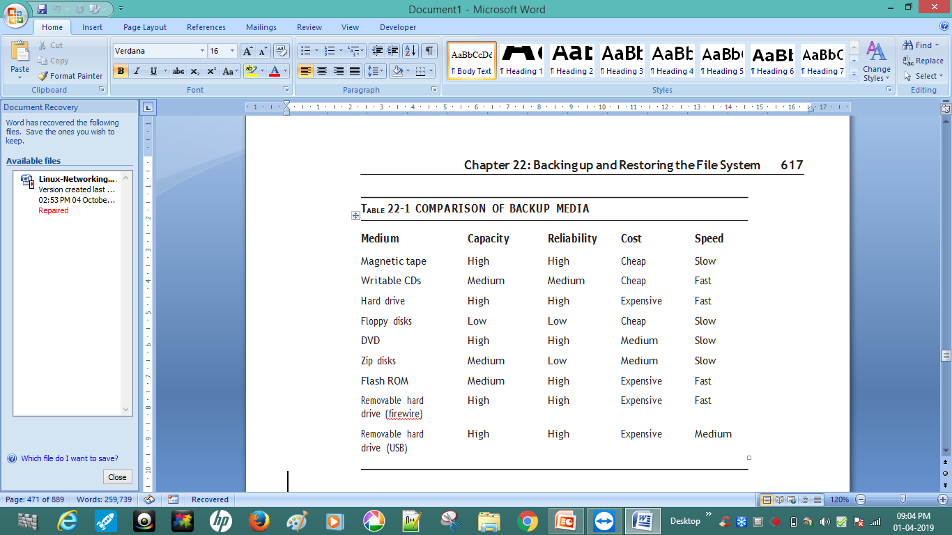
Choosing Media for Backups

Slide 51
Using Backup Tools
There are tools for interacting with backup media, such as ftape for manipulating tapes drives, cdrecord for writing to CD drivers, and mirrordir for making backups to hard drives.
Command line tools such as tar and dump allow for low-level control of file system backups and also easy automation through scripting. Using only shell scripts , you can develop a robust automated backup solution for many situations.
Graphical tools also exist to create a more user-friendly interface to performing manual backups.

Slide 52
Command line tools
Red Hat Linux provides a number of command line tools for performing backups and restoring from backups. The tools for interacting directly with backup media are ftape, cdrecord, and mirror. The standard tools for creating archives are tar and dump for tape archives and mkisofs for CD archives. Each command provides a different interface and a number of options.
USING FTAPE
The ftape package is a collection of command line tools for accessing and managing magnetic tape drives. These utilities are useful if you are using tape drives to store your backups.
The mt command is used to scan, rewind, and eject magnetic tapes if you have an IDE drive. If you have a SCSI tape drive, the st command performs the same functions.

Slide 53
USING THE CDRECORD PACKAGE
In order to make backups on CDs under Red Hat Linux, you need the cdrecord package to be installed. It contains several commands such as cdrecord, devdump, isodump, isoinfo, isovfy, and readcd. These commands are useful utilities for creating and managing writable CDs.
The cdrecord package requires that you have a SCSI CD drive. If you have an IDE CD drive, you must configure it to use SCSI emulation in order to use the cdrecord package.
The disadvantage to making backups on CD is that you must first create a CD image on the file system and then copy the CD image to the actual CD all in one step. This process requires that you have empty space on a single file system parti- tion which is large enough to hold a CD image (up to 650MB). You create a CD image with the mkisofs command:
mkisofs –o /tmp/cd.image /home/blanu

Slide 54
This command makes a CD image file in the /tmp directory called cd.image. The CD image file contains all the files in the /home/blanu directory. You must have enough space to make the image file on the partition holding the /tmp directory. You can determine how much is free with the df command. You can determine how much space the image file is going to take up using the command du /home/blanu. By default, mkisofs preserves the ownership and permissions from the file system in the CD image.
In order to burn the image file to an actual CD, you must determine which SCSI device has the CD drive. If you don’t actually have any SCSI drives and are using SCSI emulation with an IDE drive, the drive is probably on device scsi0. You can see what drives are on what SCSI devices with the following command:
dmesg | grep ^scsi

Slide 55
Next, you must determine which SCSI device ID the drive is using. You can find this with the following command:
cdrecord –scanbus
Next, you must determine the Logical Unit Number. If the device ID is zero, the Logical Unit Number should always be zero. You supply the SCSI device number, the device ID, and the logical unit number to the cdrecord command, in that order, as part of the dev option. A sample cdrecord command is as follows:
cdrecord –v dev=0,0,0 –data /tmp/cd.image

Slide 56
USING MIRRORDIR
The mirrordir command (in the mirrordir package) is a tool that enables you to easily back up a file system to an additional hard drive. In order to use mirrordir you must first mount the additional hard drive.
mount /dev/hdb1 /mnt
Then you can back up a given directory to the mounted hard drive using the
mirrordir command.
mirrordir /home /mnt

Slide 57
USING DUMP
The dump package consists of several commands for doing backup and restoration of the file system. The dump command is used to do backups of either entire parti- tions or individual directories. The restore command is used to restore an entire partition, individual directories, or individual files.
SYNTAX OF THE DUMP COMMAND The first argument to the dump command is a list of options. Following that are all of the arguments required by the various options in the same order as the options were specified. The last argument is the file system to back up. Table 22-2 lists the available dump options.

Slide 58
SAMPLE DUMP COMMAND
dump 0uf /dev/rft0 /dev/hda3
This command specifies that the file system on /dev/hda3 should be backed up on the magnetic tape on device /dev/rft0. It specifies that the backup should use backup level 0 (full backup) and write the time of the backup to the /etc/ dumpdates file.

Slide 59
USING RESTORE
The restore command is used to retrieve files from the backups created with dump. You can use restore to restore an entire file system or you can use it to interactively select which files you want to restore.

Slide 60
RESTORING THE FILE SYTEM In order to restore a damaged or erased file system you must first recreate the directory or partition that has been lost. If, for instance, you want to recreate the /home directory, which existed by itself on the /dev/hdb1 partition, you could use the following commands:
mkfs /dev/hdb1
mount /dev/hdb1 /home
Note that this command erases all of the data on the /dev/hdb1 partition. This method of restoration is useful only for restoring all of the files previously archived with dump. If any files have been added, modified, or deleted since the last backup, those changes are lost. Restoring individual files is covered in the section “Using Restore Interactively.” Also, if mkfs is accidentally run on a different partition than the one meant to be restored, all of the data on the partition on which it is mistak- enly run are irrevocably erased.

Slide 61
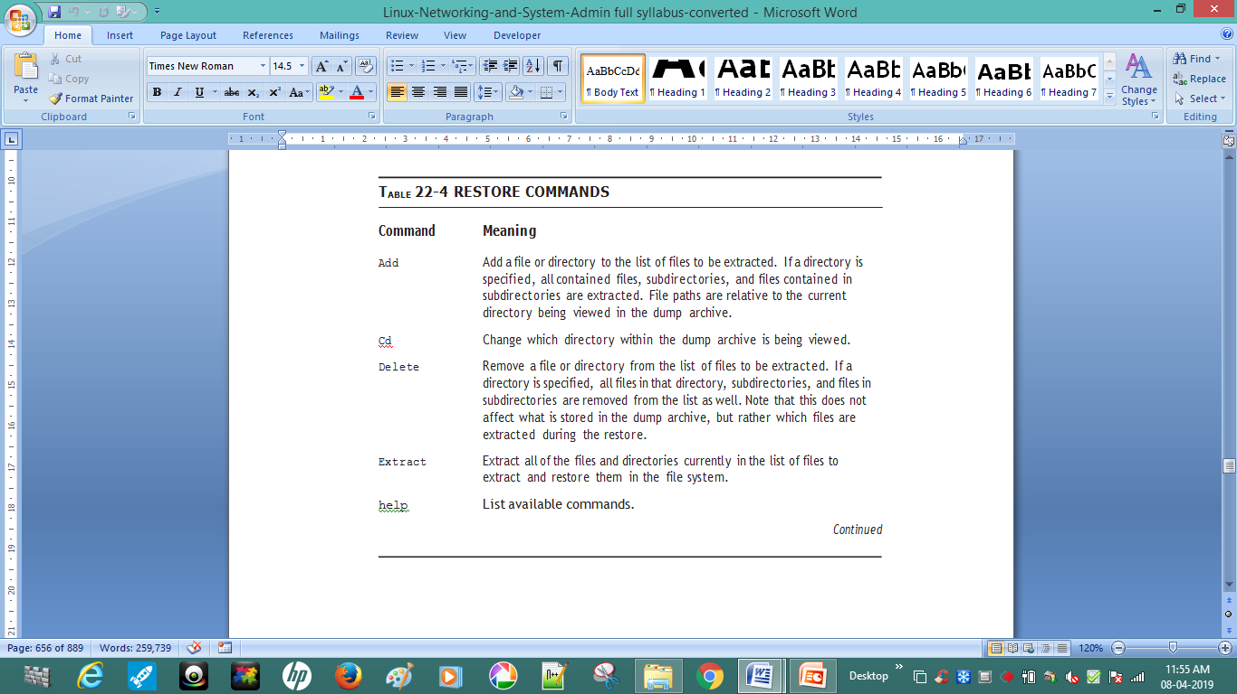

Slide 62
Installing and Upgrading Software Packages
Using the Red Hat Package Manager
RPM is a powerful software configuration manager and is the dominant tool for installing, removing, verifying, and updating
RPM consists of two components: a set of databases that store information about installed software and the programs that interface with the databases. It can work with binary and source packages.
Binary packages, generally referred to simply as RPMs, contain compiled software ready for installation. They use the file extension
.rpm. Source packages, more often called source RPMs, are uncompiled packages used to create binary RPMs and have a .src.rpm file extension.

Slide 63
NETWORK MANAGER
NetworkManager is a dynamic network control and configuration system that attempts to keep network devices and connections up and active when they are available.
NetworkManager can be used to configure the following types of connections: Ethernet, wireless, mobile broadband (such as cellular 3G), and DSL and PPPoE (Point-to-Point over Ethernet)
NetworkManager may be installed by default on your version of Red Hat Enterprise Linux. To ensure that it is, run the following command as root:
~]# yum install NetworkManager

Slide 64
The Network Manager Daemon
The NetworkManager daemon runs with root privileges and is usually configured to start up at boot time. You can determine whether the NetworkManager daemon is running by entering this command as root:
~]# service NetworkManager status
NetworkManager (pid 1527) is running...
The service command will report NetworkManager is stopped if the NetworkManagerservice is not running. To start it for the current session:
~]# service NetworkManager start
Run the chkconfig command to ensure that NetworkManager starts up every time the system boots:
~]# chkconfig NetworkManager on
For more information on starting, stopping and managing services and runlevels.

Slide 65
Package Manager
A package manager or package management system is a collection of software tools that automates the process of installing, upgrading, configuring, and removing computer programs for a computer's operating system in a consistent manner.
RPM Package Manager (Red-hat Package Manager)
RPM Package Manager (also known simply as RPM), originally called the Red-hat Package Manager, is a program for installing, uninstalling, and managing software packages in Linux.
RPM was developed on the basis of the Linux Standard Base (LSB). In latter-day usage, the "RPM" portion of this term arises from the fact that .rpm is the default extension for files used by the program.

Slide 66
The RPM contents also include a package label, which contains the following pieces of information:
software name
software version (the version taken from original upstream source of the software)
package release (the number of times the package has been rebuilt using the same version of the software).
The package label fields do not need to match the filename.

Slide 67
Why we use RPM in Linux?
There are five basic modes for RPM command
Install : It is used to install any RPM package.
Remove : It is used to erase, remove or un-install any RPM package.
Upgrade : It is used to update the existing RPM package.
Verify : It is used to verify an RPM packages.
Query : It is used query any RPM package.

